Slide 1
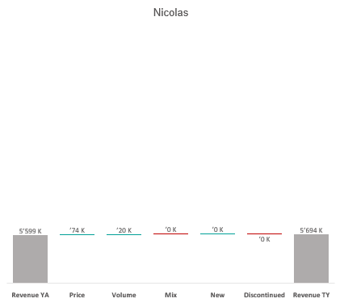
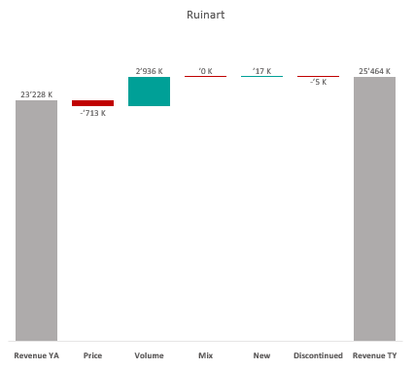
Revenue by Price vs. Volume vs. Mix analysis (Replace with So What)
Revenue by Price vs. Volume vs. Mix analysis | Nicolas vs. Ruinart | Effervescents | NATIONAL | P12M
DATA SOURCE: Trade Panel/Retailer Data | Ending June 2025

Slide 2
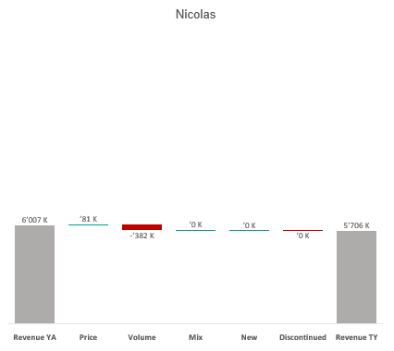
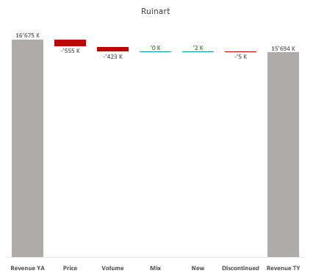
Revenue by Price vs. Volume vs. Mix analysis (Replace with So What)
Revenue by Price vs. Volume vs. Mix analysis | Nicolas vs. Ruinart | Effervescents | NICOLAS | P12M
DATA SOURCE: Trade Panel/Retailer Data | Ending June 2025

Slide 3
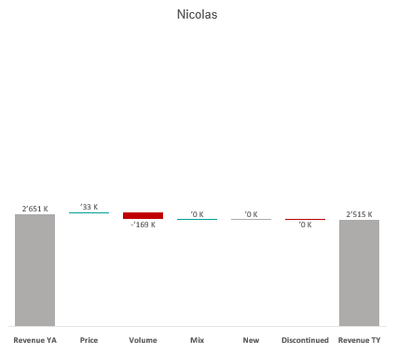
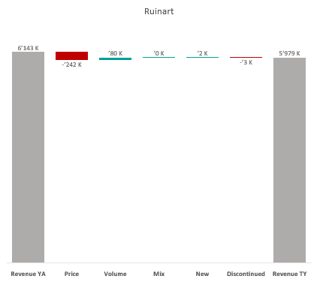
Revenue by Price vs. Volume vs. Mix analysis (Replace with So What)
Revenue by Price vs. Volume vs. Mix analysis | Nicolas vs. Ruinart | Effervescents | NICOLAS QCN | P12M
DATA SOURCE: Trade Panel/Retailer Data | Ending June 2025

Slide 4
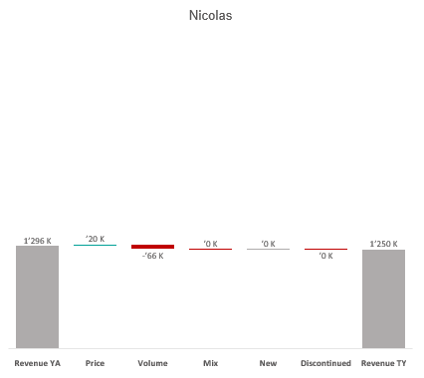
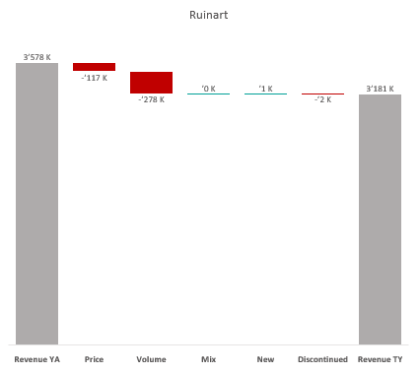
Revenue by Price vs. Volume vs. Mix analysis (Replace with So What)
Revenue by Price vs. Volume vs. Mix analysis | Nicolas vs. Ruinart | Effervescents | NICOLAS VCN | P12M
DATA SOURCE: Trade Panel/Retailer Data | Ending June 2025

Slide 5
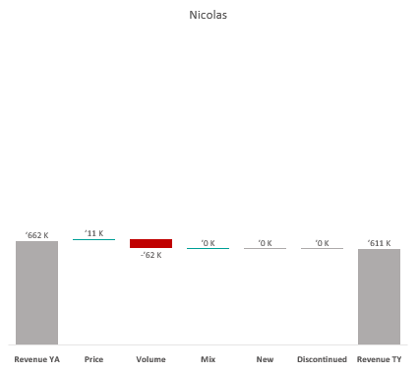
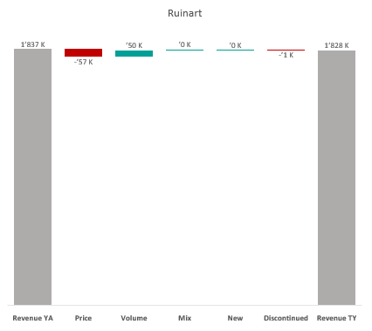
Revenue by Price vs. Volume vs. Mix analysis (Replace with So What)
Revenue by Price vs. Volume vs. Mix analysis | Nicolas vs. Ruinart | Effervescents | NICOLAS QCT | P12M
DATA SOURCE: Trade Panel/Retailer Data | Ending June 2025

Slide 6
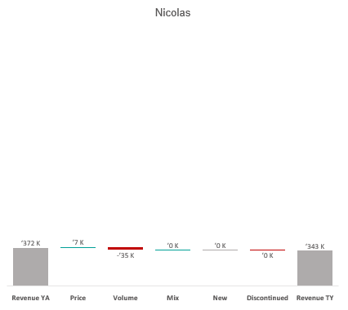
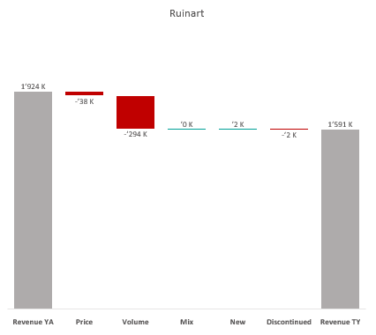
Revenue by Price vs. Volume vs. Mix analysis (Replace with So What)
Revenue by Price vs. Volume vs. Mix analysis | Nicolas vs. Ruinart | Effervescents | NICOLAS QCA | P12M
DATA SOURCE: Trade Panel/Retailer Data | Ending June 2025

Slide 7
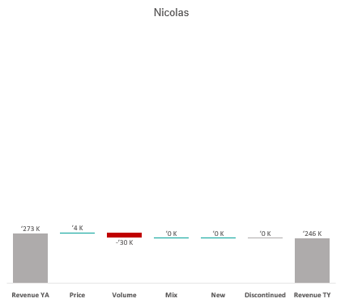
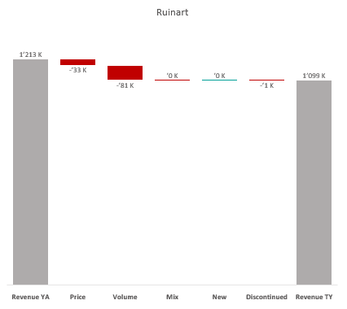
Revenue by Price vs. Volume vs. Mix analysis (Replace with So What)
Revenue by Price vs. Volume vs. Mix analysis | Nicolas vs. Ruinart | Effervescents | NICOLAS CCP | P12M
DATA SOURCE: Trade Panel/Retailer Data | Ending June 2025

Slide 8
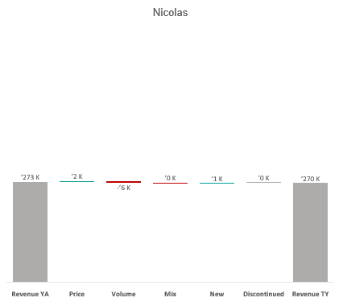
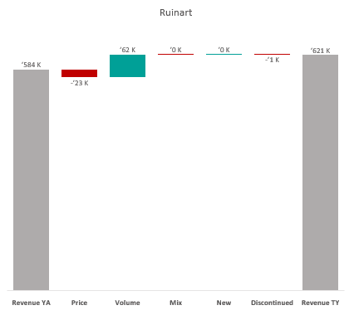
Revenue by Price vs. Volume vs. Mix analysis (Replace with So What)
Revenue by Price vs. Volume vs. Mix analysis | Nicolas vs. Ruinart | Effervescents | NICOLAS VCT | P12M
DATA SOURCE: Trade Panel/Retailer Data | Ending June 2025

Slide 9
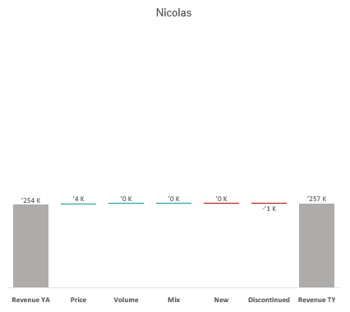
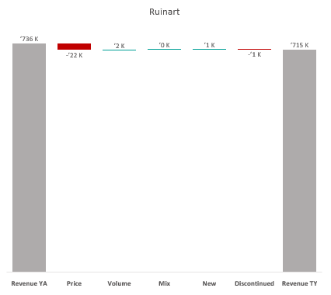
Revenue by Price vs. Volume vs. Mix analysis (Replace with So What)
Revenue by Price vs. Volume vs. Mix analysis | Nicolas vs. Ruinart | Effervescents | NICOLAS RN | P12M
DATA SOURCE: Trade Panel/Retailer Data | Ending June 2025

Slide 10
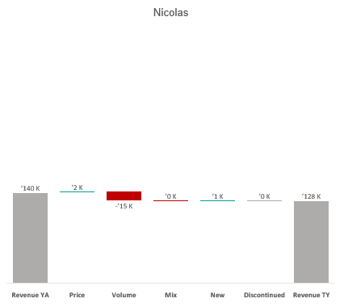
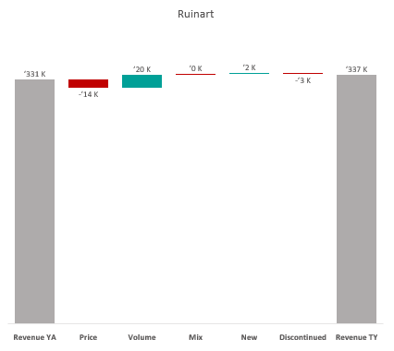
Revenue by Price vs. Volume vs. Mix analysis (Replace with So What)
Revenue by Price vs. Volume vs. Mix analysis | Nicolas vs. Ruinart | Effervescents | NICOLAS CCQ | P12M
DATA SOURCE: Trade Panel/Retailer Data | Ending June 2025

Slide 11
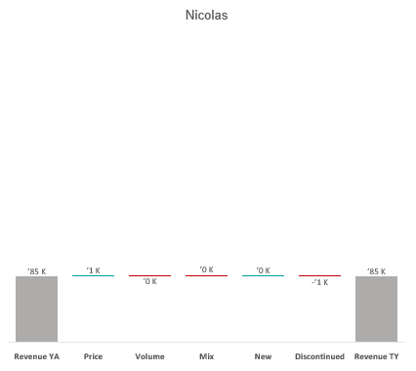
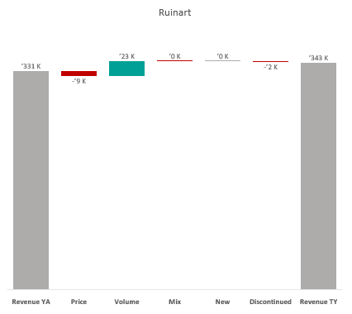
Revenue by Price vs. Volume vs. Mix analysis (Replace with So What)
Revenue by Price vs. Volume vs. Mix analysis | Nicolas vs. Ruinart | Effervescents | NICOLAS CCC | P12M
DATA SOURCE: Trade Panel/Retailer Data | Ending June 2025

Slide 12
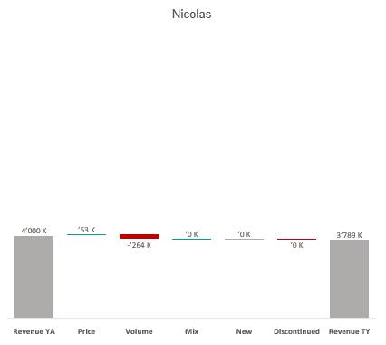
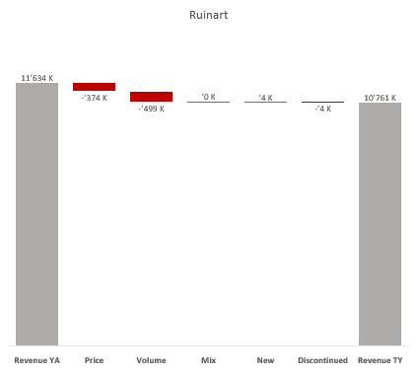
Revenue by Price vs. Volume vs. Mix analysis (Replace with So What)
Revenue by Price vs. Volume vs. Mix analysis | Nicolas vs. Ruinart | Effervescents | NICOLAS IDF | P12M
DATA SOURCE: Trade Panel/Retailer Data | Ending June 2025

Slide 13
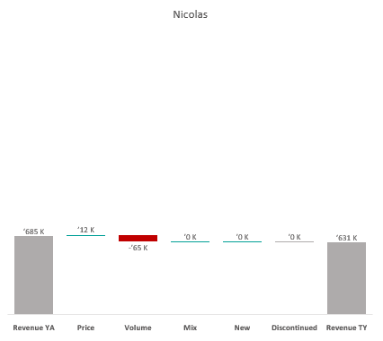
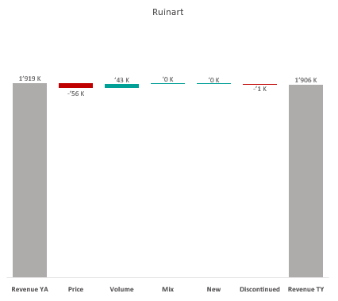
Revenue by Price vs. Volume vs. Mix analysis (Replace with So What)
Revenue by Price vs. Volume vs. Mix analysis | Nicolas vs. Ruinart | Effervescents | NICOLAS PAC | P12M
DATA SOURCE: Trade Panel/Retailer Data | Ending June 2025

Slide 14
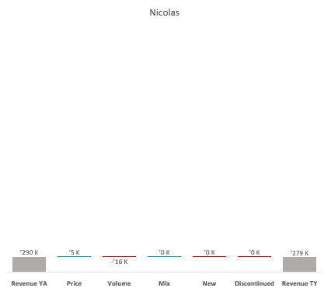
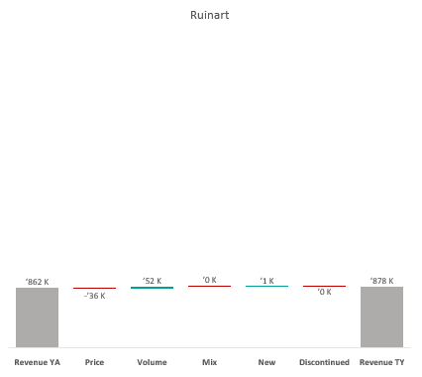
Revenue by Price vs. Volume vs. Mix analysis (Replace with So What)
Revenue by Price vs. Volume vs. Mix analysis | Nicolas vs. Ruinart | Effervescents | NICOLAS RHO | P12M
DATA SOURCE: Trade Panel/Retailer Data | Ending June 2025

Slide 15
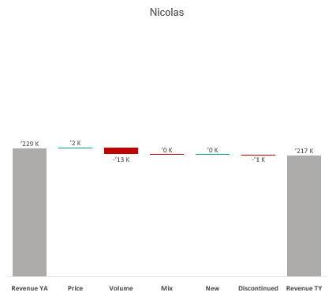
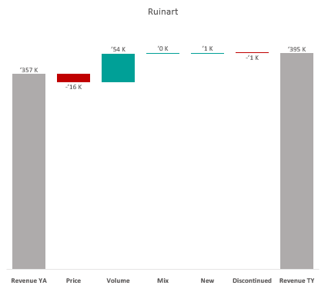
Revenue by Price vs. Volume vs. Mix analysis (Replace with So What)
Revenue by Price vs. Volume vs. Mix analysis | Nicolas vs. Ruinart | Effervescents | NICOLAS AQU | P12M
DATA SOURCE: Trade Panel/Retailer Data | Ending June 2025

Slide 16
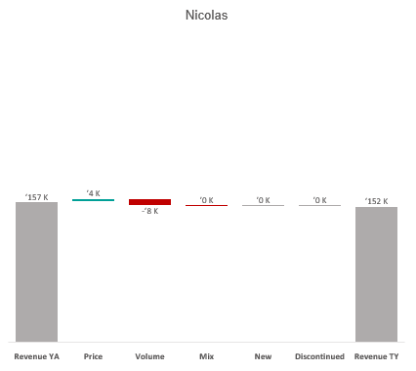
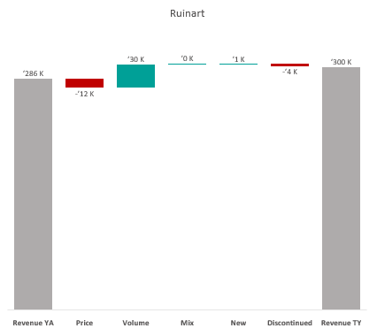
Revenue by Price vs. Volume vs. Mix analysis (Replace with So What)
Revenue by Price vs. Volume vs. Mix analysis | Nicolas vs. Ruinart | Effervescents | NICOLAS EST | P12M
DATA SOURCE: Trade Panel/Retailer Data | Ending June 2025

Slide 17
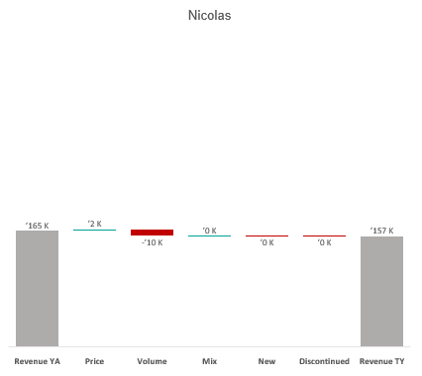
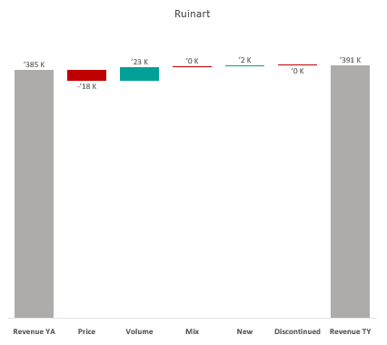
Revenue by Price vs. Volume vs. Mix analysis (Replace with So What)
Revenue by Price vs. Volume vs. Mix analysis | Nicolas vs. Ruinart | Effervescents | NICOLAS OCC | P12M
DATA SOURCE: Trade Panel/Retailer Data | Ending June 2025

Slide 18
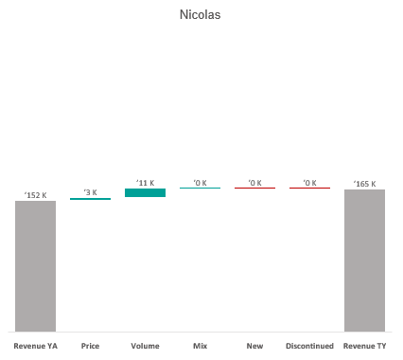
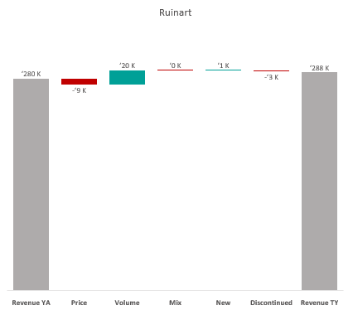
Revenue by Price vs. Volume vs. Mix analysis (Replace with So What)
Revenue by Price vs. Volume vs. Mix analysis | Nicolas vs. Ruinart | Effervescents | NICOLAS HAU | P12M
DATA SOURCE: Trade Panel/Retailer Data | Ending June 2025

Slide 19
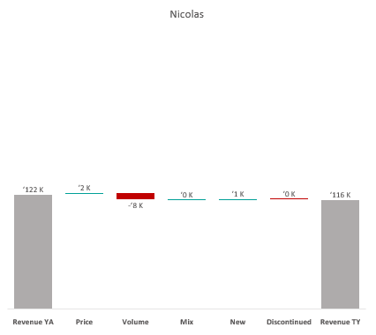
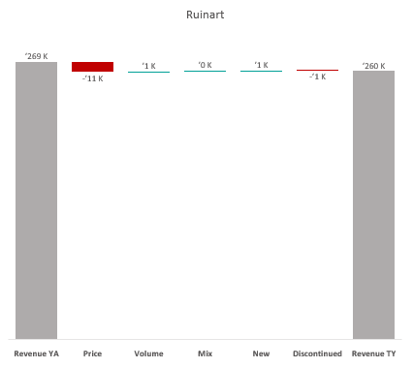
Revenue by Price vs. Volume vs. Mix analysis (Replace with So What)
Revenue by Price vs. Volume vs. Mix analysis | Nicolas vs. Ruinart | Effervescents | NICOLAS NDI | P12M
DATA SOURCE: Trade Panel/Retailer Data | Ending June 2025

Slide 20
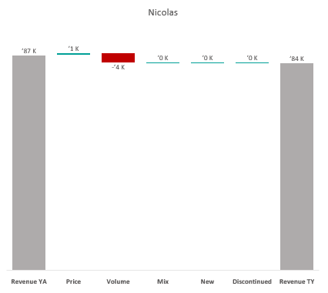
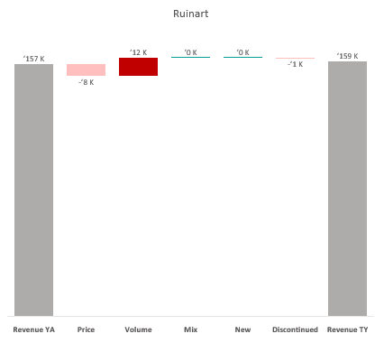
Revenue by Price vs. Volume vs. Mix analysis (Replace with So What)
Revenue by Price vs. Volume vs. Mix analysis | Nicolas vs. Ruinart | Effervescents | NICOLAS BRE | P12M
DATA SOURCE: Trade Panel/Retailer Data | Ending June 2025

Slide 21
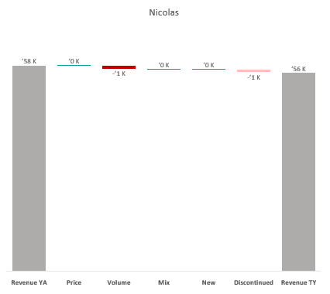
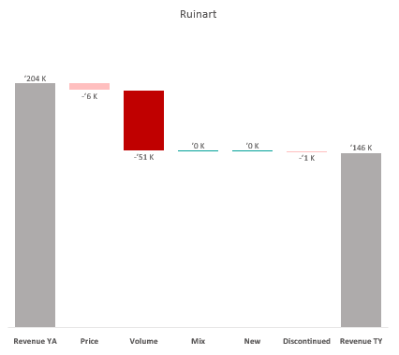
Revenue by Price vs. Volume vs. Mix analysis (Replace with So What)
Revenue by Price vs. Volume vs. Mix analysis | Nicolas vs. Ruinart | Effervescents | NICOLAS LOI | P12M
DATA SOURCE: Trade Panel/Retailer Data | Ending Apr 2024

Slide 22
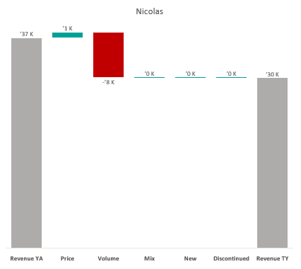
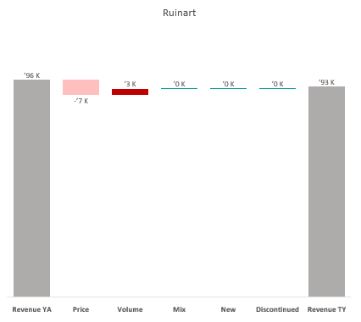
Revenue by Price vs. Volume vs. Mix analysis (Replace with So What)
Revenue by Price vs. Volume vs. Mix analysis | Nicolas vs. Ruinart | Effervescents | NICOLAS CEN | P12M
DATA SOURCE: Trade Panel/Retailer Data | Ending Apr 2024

Slide 23
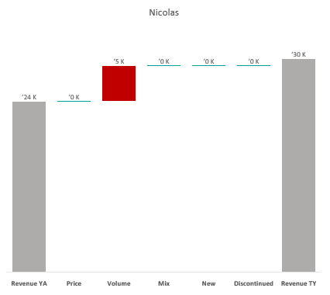
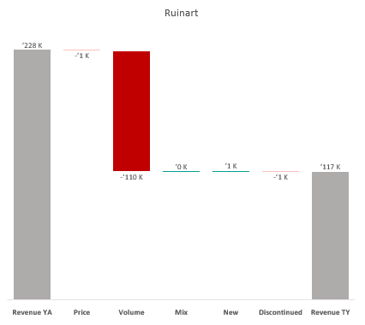
Revenue by Price vs. Volume vs. Mix analysis (Replace with So What)
Revenue by Price vs. Volume vs. Mix analysis | Nicolas vs. Ruinart | Effervescents | NICOLAS BOU | P12M
DATA SOURCE: Trade Panel/Retailer Data | Ending Apr 2024

Slide 24
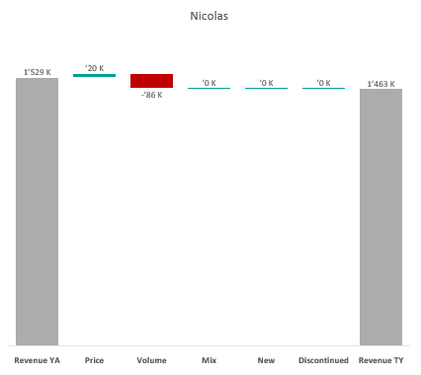
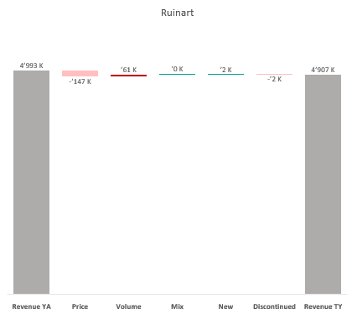
Revenue by Price vs. Volume vs. Mix analysis (Replace with So What)
Revenue by Price vs. Volume vs. Mix analysis | Nicolas vs. Ruinart | Effervescents | CA A | P12M
DATA SOURCE: Trade Panel/Retailer Data | Ending Apr 2024

Slide 25
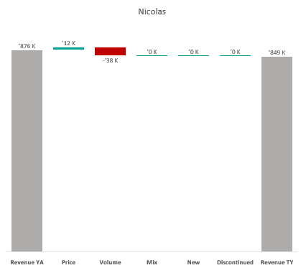
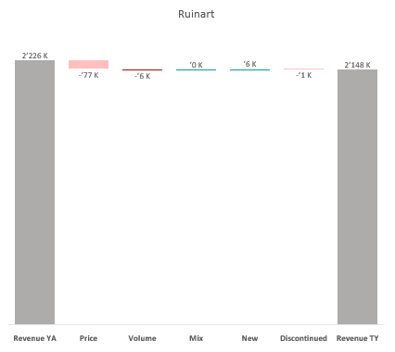
Revenue by Price vs. Volume vs. Mix analysis (Replace with So What)
Revenue by Price vs. Volume vs. Mix analysis | Nicolas vs. Ruinart | Effervescents | CA B | P12M
DATA SOURCE: Trade Panel/Retailer Data | Ending Apr 2024

Slide 26


Revenue by Price vs. Volume vs. Mix analysis (Replace with So What)
Revenue by Price vs. Volume vs. Mix analysis | Nicolas vs. Ruinart | Effervescents | CA C | P12M
DATA SOURCE: Trade Panel/Retailer Data | Ending Apr 2024

Slide 27


Revenue by Price vs. Volume vs. Mix analysis (Replace with So What)
Revenue by Price vs. Volume vs. Mix analysis | Nicolas vs. Ruinart | Effervescents | CA D | P12M
DATA SOURCE: Trade Panel/Retailer Data | Ending Apr 2024

Slide 28


Revenue by Price vs. Volume vs. Mix analysis (Replace with So What)
Revenue by Price vs. Volume vs. Mix analysis | Nicolas vs. Ruinart | Effervescents | CA E | P12M
DATA SOURCE: Trade Panel/Retailer Data | Ending Apr 2024

Slide 29
Revenue by Price vs. Volume vs. Mix analysis (Replace with So What)
Revenue by Price vs. Volume vs. Mix analysis | Nicolas vs. Ruinart | Champagnes | NATIONAL | P12M
DATA SOURCE: Trade Panel/Retailer Data | Ending June 2025

Slide 30
Revenue by Price vs. Volume vs. Mix analysis (Replace with So What)
Revenue by Price vs. Volume vs. Mix analysis | Nicolas vs. Ruinart | Champagnes | NICOLAS | P12M
DATA SOURCE: Trade Panel/Retailer Data | Ending June 2025

Slide 31
Revenue by Price vs. Volume vs. Mix analysis (Replace with So What)
Revenue by Price vs. Volume vs. Mix analysis | Nicolas vs. Ruinart | Champagnes | NICOLAS QCN | P12M
DATA SOURCE: Trade Panel/Retailer Data | Ending June 2025

Slide 32
Revenue by Price vs. Volume vs. Mix analysis (Replace with So What)
Revenue by Price vs. Volume vs. Mix analysis | Nicolas vs. Ruinart | Champagnes | NICOLAS VCN | P12M
DATA SOURCE: Trade Panel/Retailer Data | Ending June 2025

Slide 33

Revenue by Price vs. Volume vs. Mix analysis (Replace with So What)
Revenue by Price vs. Volume vs. Mix analysis | Nicolas vs. Ruinart | Champagnes | NICOLAS QCT | P12M
DATA SOURCE: Trade Panel/Retailer Data | Ending June 2025

Slide 34
Revenue by Price vs. Volume vs. Mix analysis (Replace with So What)
Revenue by Price vs. Volume vs. Mix analysis | Nicolas vs. Ruinart | Champagnes | NICOLAS QCA | P12M
DATA SOURCE: Trade Panel/Retailer Data | Ending June 2025

Slide 35

Revenue by Price vs. Volume vs. Mix analysis (Replace with So What)
Revenue by Price vs. Volume vs. Mix analysis | Nicolas vs. Ruinart | Champagnes | NICOLAS CCP | P12M
DATA SOURCE: Trade Panel/Retailer Data | Ending June 2025

Slide 36

Revenue by Price vs. Volume vs. Mix analysis (Replace with So What)
Revenue by Price vs. Volume vs. Mix analysis | Nicolas vs. Ruinart | Champagnes | NICOLAS VCT | P12M
DATA SOURCE: Trade Panel/Retailer Data | Ending June 2025

Slide 37

Revenue by Price vs. Volume vs. Mix analysis (Replace with So What)
Revenue by Price vs. Volume vs. Mix analysis | Nicolas vs. Ruinart | Champagnes | NICOLAS RN | P12M
DATA SOURCE: Trade Panel/Retailer Data | Ending June 2025

Slide 38
Revenue by Price vs. Volume vs. Mix analysis (Replace with So What)
Revenue by Price vs. Volume vs. Mix analysis | Nicolas vs. Ruinart | Champagnes | NICOLAS CCQ | P12M
DATA SOURCE: Trade Panel/Retailer Data | Ending June 2025

Slide 39


Revenue by Price vs. Volume vs. Mix analysis (Replace with So What)
Revenue by Price vs. Volume vs. Mix analysis | Nicolas vs. Ruinart | Champagnes | NICOLAS CCC | P12M
DATA SOURCE: Trade Panel/Retailer Data | Ending June 2025

Slide 40
Revenue by Price vs. Volume vs. Mix analysis (Replace with So What)
Revenue by Price vs. Volume vs. Mix analysis | Nicolas vs. Ruinart | Champagnes | NICOLAS IDF | P12M
DATA SOURCE: Trade Panel/Retailer Data | Ending June 2025

Slide 41

Revenue by Price vs. Volume vs. Mix analysis (Replace with So What)
Revenue by Price vs. Volume vs. Mix analysis | Nicolas vs. Ruinart | Champagnes | NICOLAS PAC | P12M
DATA SOURCE: Trade Panel/Retailer Data | Ending June 2025

Slide 42


Revenue by Price vs. Volume vs. Mix analysis (Replace with So What)
Revenue by Price vs. Volume vs. Mix analysis | Nicolas vs. Ruinart | Champagnes | NICOLAS RHO | P12M
DATA SOURCE: Trade Panel/Retailer Data | Ending June 2025

Slide 43
Revenue by Price vs. Volume vs. Mix analysis (Replace with So What)
Revenue by Price vs. Volume vs. Mix analysis | Nicolas vs. Ruinart | Champagnes | NICOLAS AQU | P12M
DATA SOURCE: Trade Panel/Retailer Data | Ending June 2025

Slide 44

Revenue by Price vs. Volume vs. Mix analysis (Replace with So What)
Revenue by Price vs. Volume vs. Mix analysis | Nicolas vs. Ruinart | Champagnes | NICOLAS EST | P12M
DATA SOURCE: Trade Panel/Retailer Data | Ending June 2025

Slide 45
Revenue by Price vs. Volume vs. Mix analysis (Replace with So What)
Revenue by Price vs. Volume vs. Mix analysis | Nicolas vs. Ruinart | Champagnes | NICOLAS OCC | P12M
DATA SOURCE: Trade Panel/Retailer Data | Ending June 2025

Slide 46

Revenue by Price vs. Volume vs. Mix analysis (Replace with So What)
Revenue by Price vs. Volume vs. Mix analysis | Nicolas vs. Ruinart | Champagnes | NICOLAS HAU | P12M
DATA SOURCE: Trade Panel/Retailer Data | Ending June 2025

Slide 47


Revenue by Price vs. Volume vs. Mix analysis (Replace with So What)
Revenue by Price vs. Volume vs. Mix analysis | Nicolas vs. Ruinart | Champagnes | NICOLAS NDI | P12M
DATA SOURCE: Trade Panel/Retailer Data | Ending June 2025

Slide 48


Revenue by Price vs. Volume vs. Mix analysis (Replace with So What)
Revenue by Price vs. Volume vs. Mix analysis | Nicolas vs. Ruinart | Champagnes | NICOLAS BRE | P12M
DATA SOURCE: Trade Panel/Retailer Data | Ending June 2025

Slide 49


Revenue by Price vs. Volume vs. Mix analysis (Replace with So What)
Revenue by Price vs. Volume vs. Mix analysis | Nicolas vs. Ruinart | Champagnes | NICOLAS LOI | P12M
DATA SOURCE: Trade Panel/Retailer Data | Ending June 2025

Slide 50


Revenue by Price vs. Volume vs. Mix analysis (Replace with So What)
Revenue by Price vs. Volume vs. Mix analysis | Nicolas vs. Ruinart | Champagnes | NICOLAS CEN | P12M
DATA SOURCE: Trade Panel/Retailer Data | Ending June 2025

Slide 51


Revenue by Price vs. Volume vs. Mix analysis (Replace with So What)
Revenue by Price vs. Volume vs. Mix analysis | Nicolas vs. Ruinart | Champagnes | NICOLAS BOU | P12M
DATA SOURCE: Trade Panel/Retailer Data | Ending June 2025

Slide 52


Revenue by Price vs. Volume vs. Mix analysis (Replace with So What)
Revenue by Price vs. Volume vs. Mix analysis | Nicolas vs. Ruinart | Champagnes | CA A | P12M
DATA SOURCE: Trade Panel/Retailer Data | Ending June 2025

Slide 53


Revenue by Price vs. Volume vs. Mix analysis (Replace with So What)
Revenue by Price vs. Volume vs. Mix analysis | Nicolas vs. Ruinart | Champagnes | CA B | P12M
DATA SOURCE: Trade Panel/Retailer Data | Ending June 2025

Slide 54


Revenue by Price vs. Volume vs. Mix analysis (Replace with So What)
Revenue by Price vs. Volume vs. Mix analysis | Nicolas vs. Ruinart | Champagnes | CA C | P12M
DATA SOURCE: Trade Panel/Retailer Data | Ending June 2025

Slide 55


Revenue by Price vs. Volume vs. Mix analysis (Replace with So What)
Revenue by Price vs. Volume vs. Mix analysis | Nicolas vs. Ruinart | Champagnes | CA D | P12M
DATA SOURCE: Trade Panel/Retailer Data | Ending June 2025

Slide 56


Revenue by Price vs. Volume vs. Mix analysis (Replace with So What)
Revenue by Price vs. Volume vs. Mix analysis | Nicolas vs. Ruinart | Champagnes | CA E | P12M
DATA SOURCE: Trade Panel/Retailer Data | Ending June 2025

